Slide 1
FY 2024-2025 Nonprofit Grant Opportunities Application Technical Assistance & Public Meeting Webinar January 23, 2024
WELCOME, THE WEBINAR WILL BEGIN SHORTLY
Please Note:
By default, all attendees are on mute and cameras are disabled
If you have a question, please enter in the Q&A section

Slide 2
Application Technical Assistance & Public Meeting Webinar FY 2024-2025 Nonprofit Grant Opportunities
January 23, 2024
Notes:
Welcome, my name is Alicia Tutt and I am a Senior Grant Analyst with the City overseeing some of our nonprofit grant programs.
Today’s webinar is being recorded and the recording will be posted on the website within a day or two.
All participants are logging in on mute with cameras disabled – you will have ability to raise hand and unmute at the end for live questions and answers
If you have questions during the presentation – please enter in the Q&A (at top or bottom of screen) – if they are not answered as we go through the slides we will respond at the end of the webinar
The chat box is not being monitored so be sure to enter everything in the Q&A section.
If you have questions after the webinar I encourage you to reach out to staff directly – our contact information is listed at the end of the slides.
At this time I would like to let our other presenter introduce herself - Jodie.

Slide 3
Today’s Agenda
Overview of Available Grant Funding Opportunities
Application Process
Application Questions by Grant Type
Grant Policies
Q&A

Slide 4
Polls #1-2
Notes:
Poll Questions
Population Served
Prior Funding

Slide 5
Grant Funding Opportunities
Community Service Grant (CSG)
Community Development Block Grant (CDBG)
Event Sponsorship Grant (ESG)
All three grants are for activities or events that occur between July 1, 2024, and June 30, 2025
Notes:
Three funding opportunities with the City
Start process early to get through application review, Council, CDBG public hearing
Agreements in place July 1, 2024

Slide 6
CSG Basic Information
Awarded annually by the City Council
Activities must benefit Elk Grove residents
Flexible funding source
Ongoing program costs (staffing, supplies, etc.)
Equipment purchases
Capital improvements to facilities
Maximum award: $100,000
Fundraising and one-time events are not eligible (see the Event Sponsorship Grant)
Funds should expand capacity, not replace another funding source

Slide 7
CDBG Basic Information
City receives an annual grant from the US Department of Housing and Urban Development (HUD)
Some funds may be passed through to nonprofits and governmental entities for:
Ongoing program costs (e.g., staffing, supplies, etc.)
Capital improvements to facilities
Goals
Provide decent, safe, and sanitary housing
Provide a suitable living environment
Expand economic opportunities
All programs must primarily benefit low-income households
One-person household: $60,050 annually
Four-person household: $85,750 annually
Notes:
City is an entitlement grant since 2003
15%, 15%, 70%

Slide 8
ESG Basic Information
Awarded annually by the City Council
Assistance to Elk Grove-based nonprofit organizations to host a special event that benefits the Elk Grove community
Events must take place in Elk Grove
Cannot be organized around political or religious purposes. If for religious purposes, it will be to educate the community and relate to Diversity, Equity and Inclusion and being a City Welcome to All.
Events with a fundraising component are eligible if all net proceeds will be provided to a nonprofit that serves primarily Elk Grove residents
Flexible funding
Direct funding
City facility use
In-kind services

Slide 9
Estimated 2024-2025 Budget
CSG: approximately $457,969
Final amount determined during City budget process
CDBG: approximately $910,987
Public services $136,648 (15% of award maximum)
Capital projects $637,691
Administration $136,348
Additional funding may be available for capital projects
Final amount determined by HUD later in the year
ESG: approximately $380,000
Cash $80,000
In-kind & facility use $300,000
Final amount determined during City budget process

Slide 10
Poll #3
Notes:
Poll Question
Funding Type

Slide 11
General Information

Slide 12
Grant Applications
Two applications/funding opportunities:
CSG and CDBG (combined application)
ESG
Organizations can apply for CSG, CDBG, and/or ESG
There is no limit on the number of applications eligible to submit
Each activity or event must have its own application
Different activities must have different applications (e.g., service activity and facility improvement = 2 applications)
Applications available at https://elkgrove.webgrantscloud.com/
Notes:
Two applications or funding opportunities as they are identified in WebGrants

Slide 13
Eligible Organizations
Nonprofits that are corporations, associations, agencies, or faith-based organizations with nonprofit status under the Internal Revenue Service Code
Governmental agencies that are independent of the City of Elk Grove’s government (e.g., Elk Grove Unified School District)
City departments (CDBG only)

Slide 14
Application Disclosure
Applications and supporting materials are subject to disclosure via the California Public Records Act
Sensitive information, such as bank account numbers or client names, should not be included
For required documents, redact any sensitive information before uploading
Requesting parties may be given read-only access to applications
Notes:
Unless otherwise exempt under applicable law, applications and application materials are public records. All information received from an applicant, whether received in connection with a grant application or in connection with any grant-funded activities performed, are subject to disclosure pursuant to the California Public Records Act, unless otherwise exempt.

Slide 15
Application Deadlines
CSG/CDBG
Applications due: February 14, 2024, at 11:59 pm
ESG
Applications due: February 23, 2024, at 11:59 pm

Slide 16
CSG/CDBG General Information

Slide 17
Types of Eligible Activities (incomplete list)
Services for low-income households, youth, seniors, persons with disabilities, persons experiencing homelessness, persons with mental illness, veterans, foster youth, etc.
Food assistance programs
Job training/education
Recreation and sports programs
Public safety and crime prevention
Housing assistance programs
Improvements to existing facilities
Acquisition (purchase) of new facilities

Slide 18
CSG, CDBG, or Both?
Most organizations should apply for CSG
Apply for CDBG if:
Organization has data on the number of low-income persons served, or can realistically estimate the number
Organization is willing and able to collect income and demographic data from every person served
Organization has a Unique Entity ID and is registered and in good standing at SAM.gov
Applying for more than one will not hurt your chances of getting a grant – City will determine which is the best funding source
Notes:
CDBG has additional eligibility and reporting requirements, while CSG is the most flexible funding source.

Slide 19
Budget
Eligible Costs: (incomplete list)
Ineligible Costs: (incomplete list)
Personnel/staff (salary and benefits)
Office/facility lease and utility costs
Materials and supplies
Communications (phone and Internet)
Local travel/mileage
Contractual services
Financial, IT, janitorial support, etc.
Indirect costs at no more than 10% of direct costs
Programs or services that promote religion
Political activities
Marketing, incentives, or fundraising
Payment of debt or expenses incurred prior to July 1, 2024
Entertainment, furnishings, or personal property
Meal/Food related expenses other than food assistance public service
Costs not directly related to providing service to Elk Grove residents

Slide 20
Documentation and Accounting
There is a lot of flexibility in costs the City can cover…but we require documentation for all of it
All costs need to be clearly related to the activity the City funds
Acceptable documentation includes payroll summaries, invoices or receipts, mileage logs, etc.
Keep this in mind as you think about your budget request
If activity serves non-Elk Grove residents, organization will need to have acceptable accounting methods to allocate or separate the costs

Slide 21
Funding Requests
If organization is not going to provide increased service or help more people, funding request must explain why the organization’s current funds are insufficient
If the proposed activity will serve non-Elk Grove residents, please calculate the percentage of time spent on Elk Grove participants and request no more than that percentage for any one budget item

Slide 22
ESG General Information

Slide 23
Eligible Events (incomplete list)
Event Types
Concert/Performance
Festival/Faire
Parade/Procession
Sports Tournament
Run/Walk/Race
Lecture Series/Symposium/Conference
Breakfast/Luncheon/Dinner/Reception Fundraisers

Slide 24
Planning During Health Restrictions
Events are required to comply with all applicable public health restrictions imposed by any federal, state, or local government agency
Notify the City staff in advance of any changes, including date and location changes, and/or cancellations
The City will work with each group to amend contracts as needed if there is a change in your event
Substantial changes made after preliminary awards have been determined may result in a change of funding, use of City facilities, and/or in-kind-services awarded

Slide 25
Sponsorship Requests
Direct funding
Facility use
Old Town Plaza
District56 indoor facility
District56 outdoor facility
District56 Aquatics center – for local swim teams only
In-kind
Police Department service (traffic management and overall event safety only)
Road closures/traffic management
Waste management (trash, recycle and organic carts and service)
Marketing/promotion

Slide 26
Application Process WebGrants

Slide 27
WebGrants Online Application
All applications must be completed and submitted online
WebGrants https://elkgrove.webgrantscloud.com/
Paper applications will not be accepted
Applicants must create a WebGrants account to apply
All individuals who will need access to the organization’s application should register for their own account (do not share accounts)
Each registration will be approved by City staff
Multiple organizations can be linked to any one registration (grant writers)
Multiple applications (for different projects) are allowed
Notes:
Link is also available on City website at www.elkgrovecity.org/grants
City staff must approve each registration, which could take one or two business days (although likely will be approved within a few hours)
Grant writers, after setting up an account City staff can assist with linking additional organizations to your profile.

Slide 28
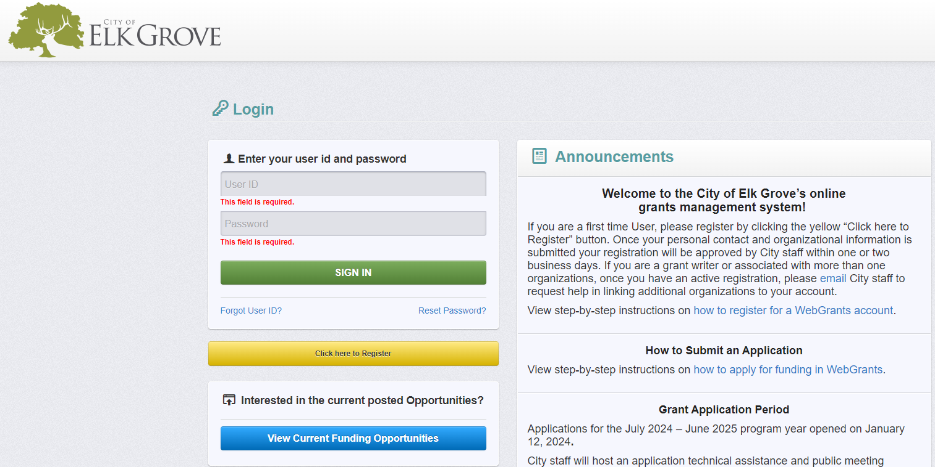
Notes:
WebGrants login page – on the righthand side blue links for Step-by-step instructional guides (also found on City webpage)
How to register for a WebGrants account
How to apply for funding in WebGrants

Slide 29
WebGrants Registration
Registers personal contact and organizational information
The first person registering an organization should enter as much information as possible
This information is important and will be tied to every other person registering for that organization and each grant application submitted on behalf of the organization
Can be added later, once account is set up, under “My Profile”
If your organization is already registered, you only need to complete the required* fields
Organization Attachments should be reviewed annually and updated as necessary
All applicants requesting CDBG funding must have SAM Unique Entity ID
Notes:
Fairly self-explanatory
Attachments – some of these used to be required for each grant application. With this new system we can collect at the organization level rather than required organizations to submit multiple times. These include Articles of Incorporation, Bylaws, Current Board of Director’s List, IRS Federal Tax-Exempt Letter, and signed W-9

Slide 30
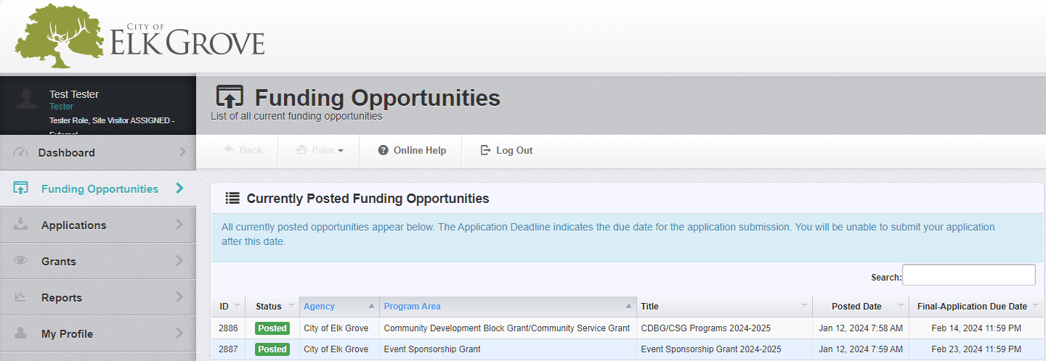
WebGrants Tips
Make sure you have the right Funding Opportunity:
Community Development Block Grant/Community Service Grant
Event Sponsorship Grant

Slide 31
WebGrants Tips Cont.
Fully read the Funding Opportunity Details and Description
Add additional applicants (users) from organization under the General Information Page
All application components (forms), required questions, and required attachments must be complete before you are able to submit
Prior to submitting application – can edit as often as you wish
You can submit more than one application for each Funding Opportunity

Slide 32
WebGrants Tips Cont.
Application does not save automatically when you click between questions
Blue Text almost always indicates a clickable link, either within the system or to an external source
Required fields are shown in red text with a red asterisk*
If you try to save a form and nothing happens you likely are missing text in a required field - scroll through the form and look for any red text identifying ‘This field is required’

Slide 33
WebGrants Tips Cont.
Entering text
Only plain text allowed - fancy formatting will not show up
Tip – You can use the <br> tag if you want a line break (a new line); it will however use extra characters so be careful. Example 1: This is a sentence without line breaks. Example 2: This is <br> a sentence <br><br>with line breaks.
Be aware of maximum character counts for each text box – especially important when cutting and pasting since it will cut off text and not warn you
Formatting and special characters do not copy over when cutting and pasting – please proofread and edit before submitting
To paste with out formatting, press Ctrl+Shift+V instead of Ctrl+V
This is
a sentence
with line breaks
This is a sentence without line breaks.

Slide 34
Attachments
Includes a list of required documents
You must upload a document for every required* document, or you will not be able to submit
Click the online help button at top of screen for definitions of required attachments
If your organization doesn’t have a certain document, please contact City staff
Many file extensions are supported (e.g., .DOC, .XLS, .PDF, .PPT, .JPG, etc.)
Check document requirements early
Supporting Materials
Add anything else you would like the City to have
Secretary of State Certificate of Status
May submit printout from website or order actual Certificate of Status
https://bizfileonline.sos.ca.gov/search/business
Notes:
Check the required attachments page early since some items may take awhile to pull together
Some attachments are captured when the organization registers

Slide 35
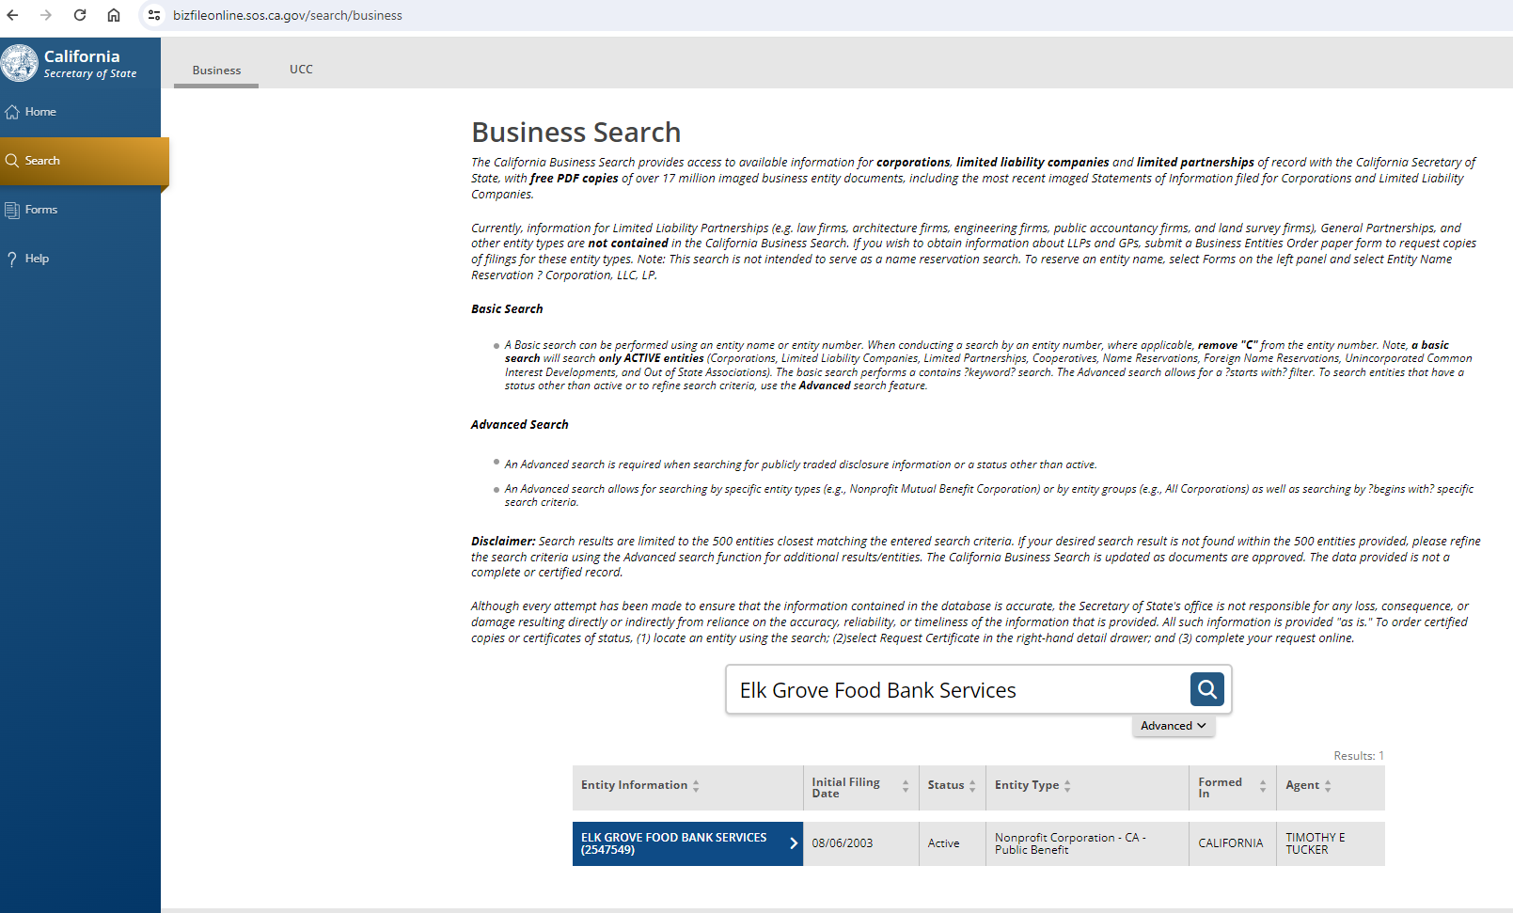

Slide 37
Submitting the Application
WebGrants will send an email confirming submittal
Once submitted, applications may not be edited
WebGrants will automatically close application period at 11:59 pm on the deadline
Notes:
Staff is not monitoring application close at 11:59 pm – please make sure all questions are directed to staff in time to answer during normal business hours prior to the deadline.

Slide 38
WebGrants Technical Assistance
Step-by-Step Instructional Guides
https://elkgrove.webgrantscloud.com/
www.elkgrovecity.org/grants
‘Online Help’ links at top of application
City Staff
CDBG/CSG - Alicia Tutt at atutt@elkgrovecity.org or 916-627-3735
ESG - Jodie Moreno at jmoreno@elkgrovecity.org or 916-478-3632
Notes:
Archived video of this webinar - www.elkgrovecity.org/grants

Slide 39
CSG/CDBG Application
Applications due: February 14, 2024, at 11:59 pm
Late applications will not be accepted

Slide 40
Application Components (Forms)
General Information
Project Overview
Organization Information
CDBG Eligibility
Budget
Attachments
Registrations and Certifications

Slide 41
Project Overview
Project Category and Type of Activity
Project Description
A short description of what you are requesting funding for
Scope of Services
Description of specifics of activity proposed for City funding (who, what, when, where)
Location of Services
Where will proposed activity occur?
Project Timeline
Start and completion dates, how often, significant dates, milestones, etc.
Cost to Participate

Slide 42
Project Overview Cont.
Beneficiaries (July 1, 2024 – June 30, 2025)
Include only people who receive service, not all people who could use the service if desired
Do not count the same person/household more than once, even if they receive service every day
Be realistic – you will be held to these goals!
Persons vs Households
Participant Income Level
Must have the same total as Persons/Households Served - Place of Residence
Beneficiaries Place of Residence

Slide 43
Organization Information
Organizational Overview
Insurance
Other Grants
List other grants applied for in the past 2 years
This is important—Council indicated in past years that grantees should be actively looking to reduce their reliance on City funding
Partial Funding
Could the proposed activity be undertaken with a reduced commitment of funding?
If yes, explain how (i.e., reduction in services or numbers served)
Organizational Assets
Total assets - amount can often be found in annual audit
Liquid assets
This includes cash or assets that could be easily converted to cash, such as stocks
Real property, materials/supplies, etc. are NOT liquid assets
Restricted assets – these are formally limited to a specific use, such as a building purchase fund
Notes:
Overview - Summarize all services provided by the organization.
Experience – demonstrate capacity to manage grant funding
Management – positions responsible for implementing proposed activity
Partner Agencies – will any other agency assist with implementation (referrals, additional services, etc.)

Slide 44
CDBG Eligibility
Funding Type
CDBG National Objectives
https://www.hudexchange.info/resource/687/playing-by-the-rules-a-handbook-for-cdbg-subrecipients-on-administrative-systems/
CDBG Proposed Goal
Broad in scope, general statement on proposed program/activity's purpose
Observable and measurable end result
CDBG Proposed Objectives
Specific result achieved within time frame of grant
Specific, measurable, action-oriented, realistic, time-bound
CDBG Proposed Outcomes – performance measures
Measurement and evaluation of activity’s results
Short- and long-term benefits

Slide 45
Example
Goal
XYZ Organization will provide free childcare to low-income households in Elk Grove
Objectives
Work with 10 local service organizations to educate 200 low-income Elk Grove households on available resources by December 31, 2024
Register 30 low-income Elk Grove households in the free childcare program by June 30, 2025
Outcomes
Direct outcome: provide 20 hours of childcare each week for low-income households in Elk Grove
Short-term benefit: parent finds employment
Long-term benefit: child is better prepared for school
Outcome measure: number of parents employed at beginning and end of project

Slide 46
Budget
Budget Summary
Common categories of expenditure pre-filled
‘Other’ categories can be used for planned expenditures that do not fit the fields provided (description required)
Indirect Costs
Personnel Expenses
Show all relevant personnel, even if not proposed for City funding
Click ‘Add Row’ for each staff position that would dedicate time to proposed project
Budget Narrative
For each category in which funding is requested, provide a description of what anticipated expenses are included and how the funds will be spent
Strongly recommend applications requesting more than $5,000 include a more detailed budget and budget narrative as Supporting Documentation
Notes:
Complete the form below making sure to detail the full cost of providing the proposed project. The “Requested Amount” is the amount of funding the organization is requesting in grant funds from the City. The “Matching Funds” category should include all other funding sources used for the proposed project. "In-kind Contributions" should include the cash value of non-monetary contributions necessary for the organization to provide the proposed project. Please use the “Other” categories for planned expenditures that do not fit in the fields provided. A short description must be provided if using these categories. *The 10% de minimis indirect cost rate may be used by any non-federal entity that has never received a negotiated indirect cost rate. This rate would be charged against modified total direct costs (MTDC). MTDC includes all direct salaries and wages, applicable fringe benefits, materials and supplies, services, and travel. MTDC does not include equipment, capital expenditures, rental costs, tuition remission, scholarships and fellowships, and participant support costs. The 10% de minimis rate must only be used to pay for overhead costs that are not directly charged to the grant. If an applicant has an approved negotiated indirect cost allocation plan a copy should be included under the 'Attachments' tab.

Slide 47
Application Review Criteria
Project feasibility
Budget reasonableness
Agency capacity
Impact on priority needs
New or increased service
Leveraged funds
Self-support plans

Slide 48
Application Review Process
Follow-up questions sent to most applicants
Questions will be sent through WebGrants between February 21 - March 1
Short turn around time for responses
Please respond so we can fairly evaluate your application
Notes:
February 21 - March 1
Questions will be sent through WebGrants and will go to those accounts associated with the application
Short turn around time for responses – a few days to a week
Failure to respond means we have less information to provide Executive Team and City Council should questions arise

Slide 49
CSG/CDBG Application Anticipated Timeline
Jan 12 Release of Application
Jan 23 Application Workshop and Public Meeting
Feb 14 Deadline for application submissions
Feb 15 - Mar 11 Review period
Mar 27 City Council public hearing (preliminary awards)
https://www.elkgrovecity.org/city-council/council-meetings
Apr 8 - May 8 CDBG Action Plan public review period
May 8 City Council public hearing (final awards)
July 1 Funding year begins
Notes:
The City anticipates the following schedule for reviewing submitted applications and determining funding awards:
Please note – March 27 council date – this is where funding recommendations will be presented to Council. Agenda with links to the Staff Report detailing funding recommendations will be emailed out the Friday before the meeting. Applicants can attend the meeting and/or view the archived meeting on the city’s website.

Slide 50
Poll #4
Notes:
Poll Question
Critical Programming

Slide 51
ESG Application
Applications due: February 23, 2024, at 11:59 pm
Late applications will not be accepted

Slide 52
Application Components (Forms)
General Information
Overview
Sponsorship Request
Details
Audience
Budget
Registrations and Certifications
Attachments

Slide 53
Overview
Event Type
Choose the type of event you are hosting and if not listed, choose other
If “Other” we may reach out and ask what kind of event
Change in Public Health Requirements
Plan for event if public health orders change
Contingency plans
Event Description
What activities will occur during the event?
Be specific – this is used to develop grant agreement

Slide 54
Overview Cont.
Date(s) of Event & Location of Event
If unconfirmed put anticipated date/location and as soon as confirmed it’s important to provide an update to the City
Hours of Event
Be specific on set-up and tear-down as those will be included on your agreement and helps us budget accordingly

Slide 55
Sponsorship Request
Type of Sponsorship Requesting
Applicants can ask for cash, facility use, and in-kind services
Note: Old Town Plaza is a beautiful outdoor only venue / grant only covers cost of the rental facilities and not other hard costs: security, staff, etc.…and is subject to availability
Staff will work with you on alternate dates or facilities if your 1st preference is not available – District56 is already booked for most weekends, so a Thursday, Friday or Sunday is most likely more open than a Saturday
Other (e.g., emcee, speakers, swag, etc.)
In-kind Services
City will not provide Police as security. Grantees are responsible for coordinating their own event security
City does not have any equipment available for grants or rent

Slide 56
Details
Road Closures
If you are asking to close a road, there will be additional requirements like a map, a Street Use Permit to be filed, a Special Events Permit with CSD Fire, and a meeting with PD and Public Works months prior to your event to confirm logistics
Permits are an additional cost not covered by the grant
Food and drink
Depending on how many food and drink vendors you have, you may be required to file for a Health permit with Sacramento County Health Department.
If serving alcohol, you will need an abc permit, as well as alcohol liability on your insurance

Slide 57
Registrations and Certifications
Food Recycling
California Law SB 1383 is aimed at reducing short-lived climate pollutants and equates to food recycling
The City requests you work hard to help with separation of recycling, organics and garbage at your events
Eventually, this will be mandated and enforced

Slide 58
ESG Application Anticipated Timeline
Jan 12 Release of Application
Jan 23 Application Workshop and Public Meeting
Feb 23 Deadline for application submissions
Mar 4 – Apr 5 Review period
Apr 24 Funding recommendations presented to City Council (preliminary awards)
May/June City Council approves annual budget (final awards)
July 1 Funding year begins
Notes:
The City anticipates the following schedule for reviewing submitted applications and determining funding awards:

Slide 59
Grant Policies
Agreement dates:
July 1, 2024, to June 30, 2025
Notes:
POLL
Community Need

Slide 60
Basic Information
Awarded applicants will receive one or more grant agreements based on the funding source
Agreements are sent electronically through DocuSign (hard copy option)
Read carefully before signing! Most edits will require a formal amendment once the agreement has been executed.
Insurance coverage is required
Types and amounts will vary based on activity/event
City will not sign the agreement until the insurance requirements are met
File Retention
CSG/CDBG - all grant-related files must be maintained for five (5) years
ESG – all grant-related files must be maintained for two (2) years
Notes:
Insurance – City works with a third party to manage. If awarded, City staff will guide you through the submission process.

Slide 61
Organizational Standing
Grantees must be in good standing with both the California Secretary of State and the California Attorney General’s Registry of Charitable Trusts, if required by law to be registered
Registration – CA Secretary of State
Check at https://bizfileonline.sos.ca.gov/
Registration – CA Attorney General
Check at http://rct.doj.ca.gov/MyLicenseVerification/Search.aspx?facility=Y
Organizational standing must be active/current prior to execution of agreement and throughout grant terms
CDBG subrecipients must have a SAM Unique Entity ID (UEI) and maintain an active registration in https://sam.gov/

Slide 62
Communications & City Logo
Grantee shall include the City’s name and/or logo in all materials identifying any person or entity as being a sponsor of, donor, or contributor to the activity/event or the Grantee
In instances where Grantee receives funding related to the arts, such communications shall also display the logo for the Elk Grove Arts Commission
Grantee must obtain permission of the City before including the City’s name or logo in any communication

Slide 63
Payment Policies
Payment requests submitted on WebGrants
CSG/CDBG - Reimbursement only and must have adequate back-up documentation
ESG – Payment may be requested in advance, no more than 30 days prior to event date
All required documentation (e.g., reports, event summary forms, permits, etc.) must be submitted and approved prior to payment request being paid
Organizational standing with Secretary of State, Registry of Charitable Trusts, and SAM (if required) must be active/current for the City to disburse funds
Failure to comply with terms and conditions of agreement (including but not limited to complying with applicable public health restrictions, meeting goals, etc.) may result in the City reducing or terminating funding

Slide 64
Required Reporting
Reports submitted in WebGrants
CSG/CDBG
Quarterly and/or mid-year reports to show persons served
CDBG recipients must collect info on demographic characteristics and income
Annual report describing persons served and accomplishments
Financial reporting, type depends on amount of grant
ESG
Post-event Summary Report including financial summary and attendance numbers

Slide 65
Technical Assistance and Monitoring
Staff is available to help grantees throughout the year
On-site assistance for reporting and invoicing
Review/discuss modifications to scope of work and/or budget
Help navigating WebGrants
All grants are subject to a financial and program audit by City staff
CSG/CDBG - periodically complete a monitoring visit where we look at financial and program information

Slide 66
Questions?

Slide 67
Copies of the PowerPoint slides and a recording of this webinar will be made available at: www.elkgrovecity.org/grants

Slide 68
Service Provider Community Needs Survey: https://forms.office.com/g/Qs6Y6aF8R0
Notes:
Service Provider Community Needs Survey – Survey open until February 29

Slide 69
Thank you for attending!
Alicia Tutt, Senior Grants Analyst
916.627.3735 | atutt@elkgrovecity.org
Jodie Moreno, Community Events Program Manager
916.478.3632 | jmoreno@elkgrovecity.org
Notes:
Training survey will pop up

